Slide 1
Community Advisory Committee
Brief Orientation
October 31, 2013

Slide 2

The Administration on Intellectual and Developmental Disabilities

Slide 3
The
Developmental
Disabilities Act
“DD Act”
Administration on Intellectual and Developmental Disabilities (AIDD)
University
Centers for
Excellence in
Developmental
Disabilities
CCIDS
Protection &
Advocacy
Disability Rights
Center of Maine
Developmental
Disabilities
Councils
Maine DD
Council
Projects of
National
Significance
(NEAT Peer-to
Peer Project)
Notes:
Flow chart of DD Act programs (UCEDD, P&A, DDC, PNS)

Slide 4
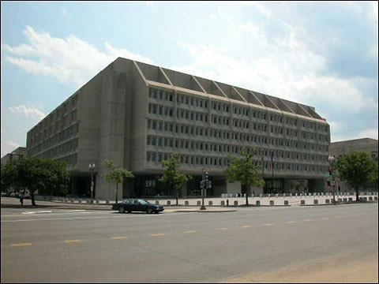

AIDD is located in the Health and Human Services Building in Washington, DC
Notes:
Picture of Health and Human Services Building in Washington DC.

Slide 5
Mission of the DD Act of 2000
“To assure that individuals with developmental disabilities and their families participate in the design of, and have access to needed community services, individualized supports, and other forms of assistance that promote self-determination, independence, productivity, and integration and inclusion in all facets of community life…”
(Subtitle B – Section 121 – PL 106-402)

Slide 6
Themes
The DD Act Programs all share 3 major themes:
Advocacy
Capacity Building
Systemic Change

Slide 7
Advocacy: active support for a program, initiative, or change
Capacity Building: strengthening local, state, regional, and national communities
Systemic Change: modifying entire programs, policies, services, and/or funding streams

Slide 8
The Basics:
University Centers for Excellence in Developmental Disabilities (UCEDD) and the
Community Advisory Committee (CAC)

Slide 9
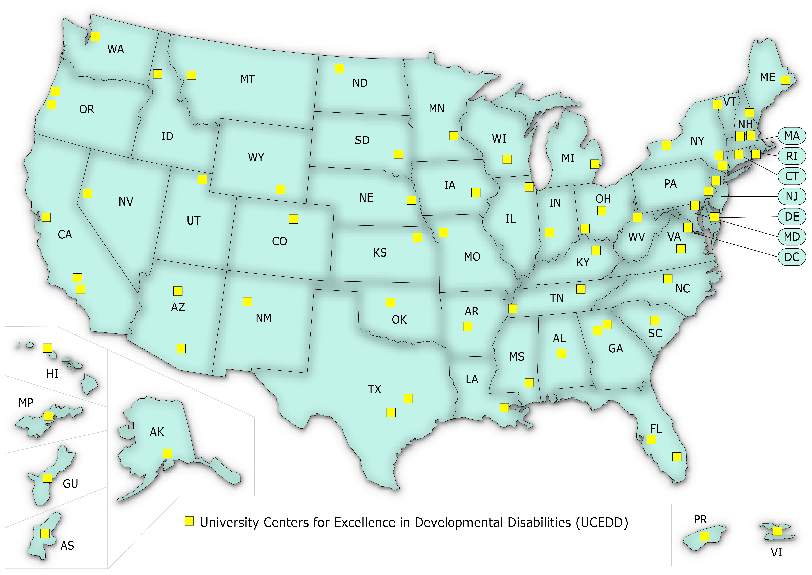
National Network of UCEDDs

Slide 10
In General, What is a UCEDD?
UCEDDs are leaders in four core function areas…
Training
Service
Research
Information Sharing
…all related to people with developmental disabilities
Notes:
Picture of a hand holding a magnifying glass

Slide 11
UCEDDs advise federal, state, and local policymakers on strategies to promote:
  Self-determination
  Independence
  Productivity
  Community integration
  of people with developmental disabilities
Notes:
Picture of a person standing at an easel

Slide 12

UCEDDs
UCEDDs must be associated with a University
Notes:
Photo of a building

Slide 13

Understanding the UCEDD
Ice Cream Metaphor:
All UCEDDs start with the basic ingredients but become their own particular flavor
Notes:
Photo of scoops of ice cream

Slide 14
Core Funding and Leveraging Funds
UCEDDs apply to AIDD for core funding
UCEDDs submit a 5-Year Plan to AIDD
The DD Act requires the UCEDD to use the core funding to leverage funding
  Leverage funding means to get money from other sources
  UCEDDs do this by getting other grants and contracts
Notes:
Picture of a piece of paper

Slide 15
The State DD Network

Slide 16
What is the State DD Network?
UCEDD + DD Council + P&A = State DD Network
DD Council
DD Act
P&A
UCEDD
Notes:
Graphic of 3 state DD Act programs

Slide 17
In Maine, SUFU is also considered a member of the State’s DD Network

Slide 18
The Community Advisory Committee (CAC)
So where do you fit in the picture?

Slide 19
What does the DD Act say about the Purpose of the CAC?
Advise the director
Provide guidance and feedback in the development of the 5-year plan
Each year, provide guidance and feedback on how the UCEDD is doing with their 5-year plan
Notes:
Graphic of mountain climbers helping each other

Slide 20


What does the DD Act say about the Members of the CAC?
The majority (over half of the CAC members) must be individuals with developmental and related disabilities and family members
Notes:
Graphic of two people ready to provide advice

Slide 21
The CAC must also include representatives from:
  State P&A
  State DD Council
  Other UCEDDs in state
  Self-Advocacy organization
And may include representatives from organizations such as:
  Parent and Training Information Center
  Those carrying out the Assistive Technology Act
  Relevant state agencies
  Community groups concerned with people with developmental disabilities and their family members

Slide 22
What is the Basic Role of a CAC?
Advise and guide the work of the UCEDD
Help create and move toward the vision of the UCEDD
Serve as an informal bridge between the community and the university in our state

Slide 23
Advisory Committees vs. Boards
A Board of Directors guides an organization, and its members are legally responsible for the actions of the organization.
Advisory Committees offer advice to an organization, but its members have no legal responsibility for the actions of the organization.
UCEDDs have Advisory Committees
Notes:
Graphic of people at a meeting

Slide 24
What are Benefits of the
CAC-UCEDD Relationship?
The CAC is a bridge from the university and the UCEDD to the community.
Participation in the CAC can be a leadership opportunity for members as disability advocates and mentors.
CACs bring together decision-makers and people with different ways of looking at issues that may not have met before.
CACs provide an opportunity for a culturally diverse forum on disability.
Notes:
Graphic of a bridge

Slide 25
END

