Slide 1
Autism Spectrum Disorder Related Activities
Alan Kurtz
Coordinator of Education and Autism

Slide 2
ASD-Related Activities
Survey research on the needs of students with ASD
Technical Assistance to schools and agencies
Participation on statewide committee examining evidence-based practices
Act Early with Maine DD Council
Maine Strategic Plan for ASD and Act Early

Slide 3
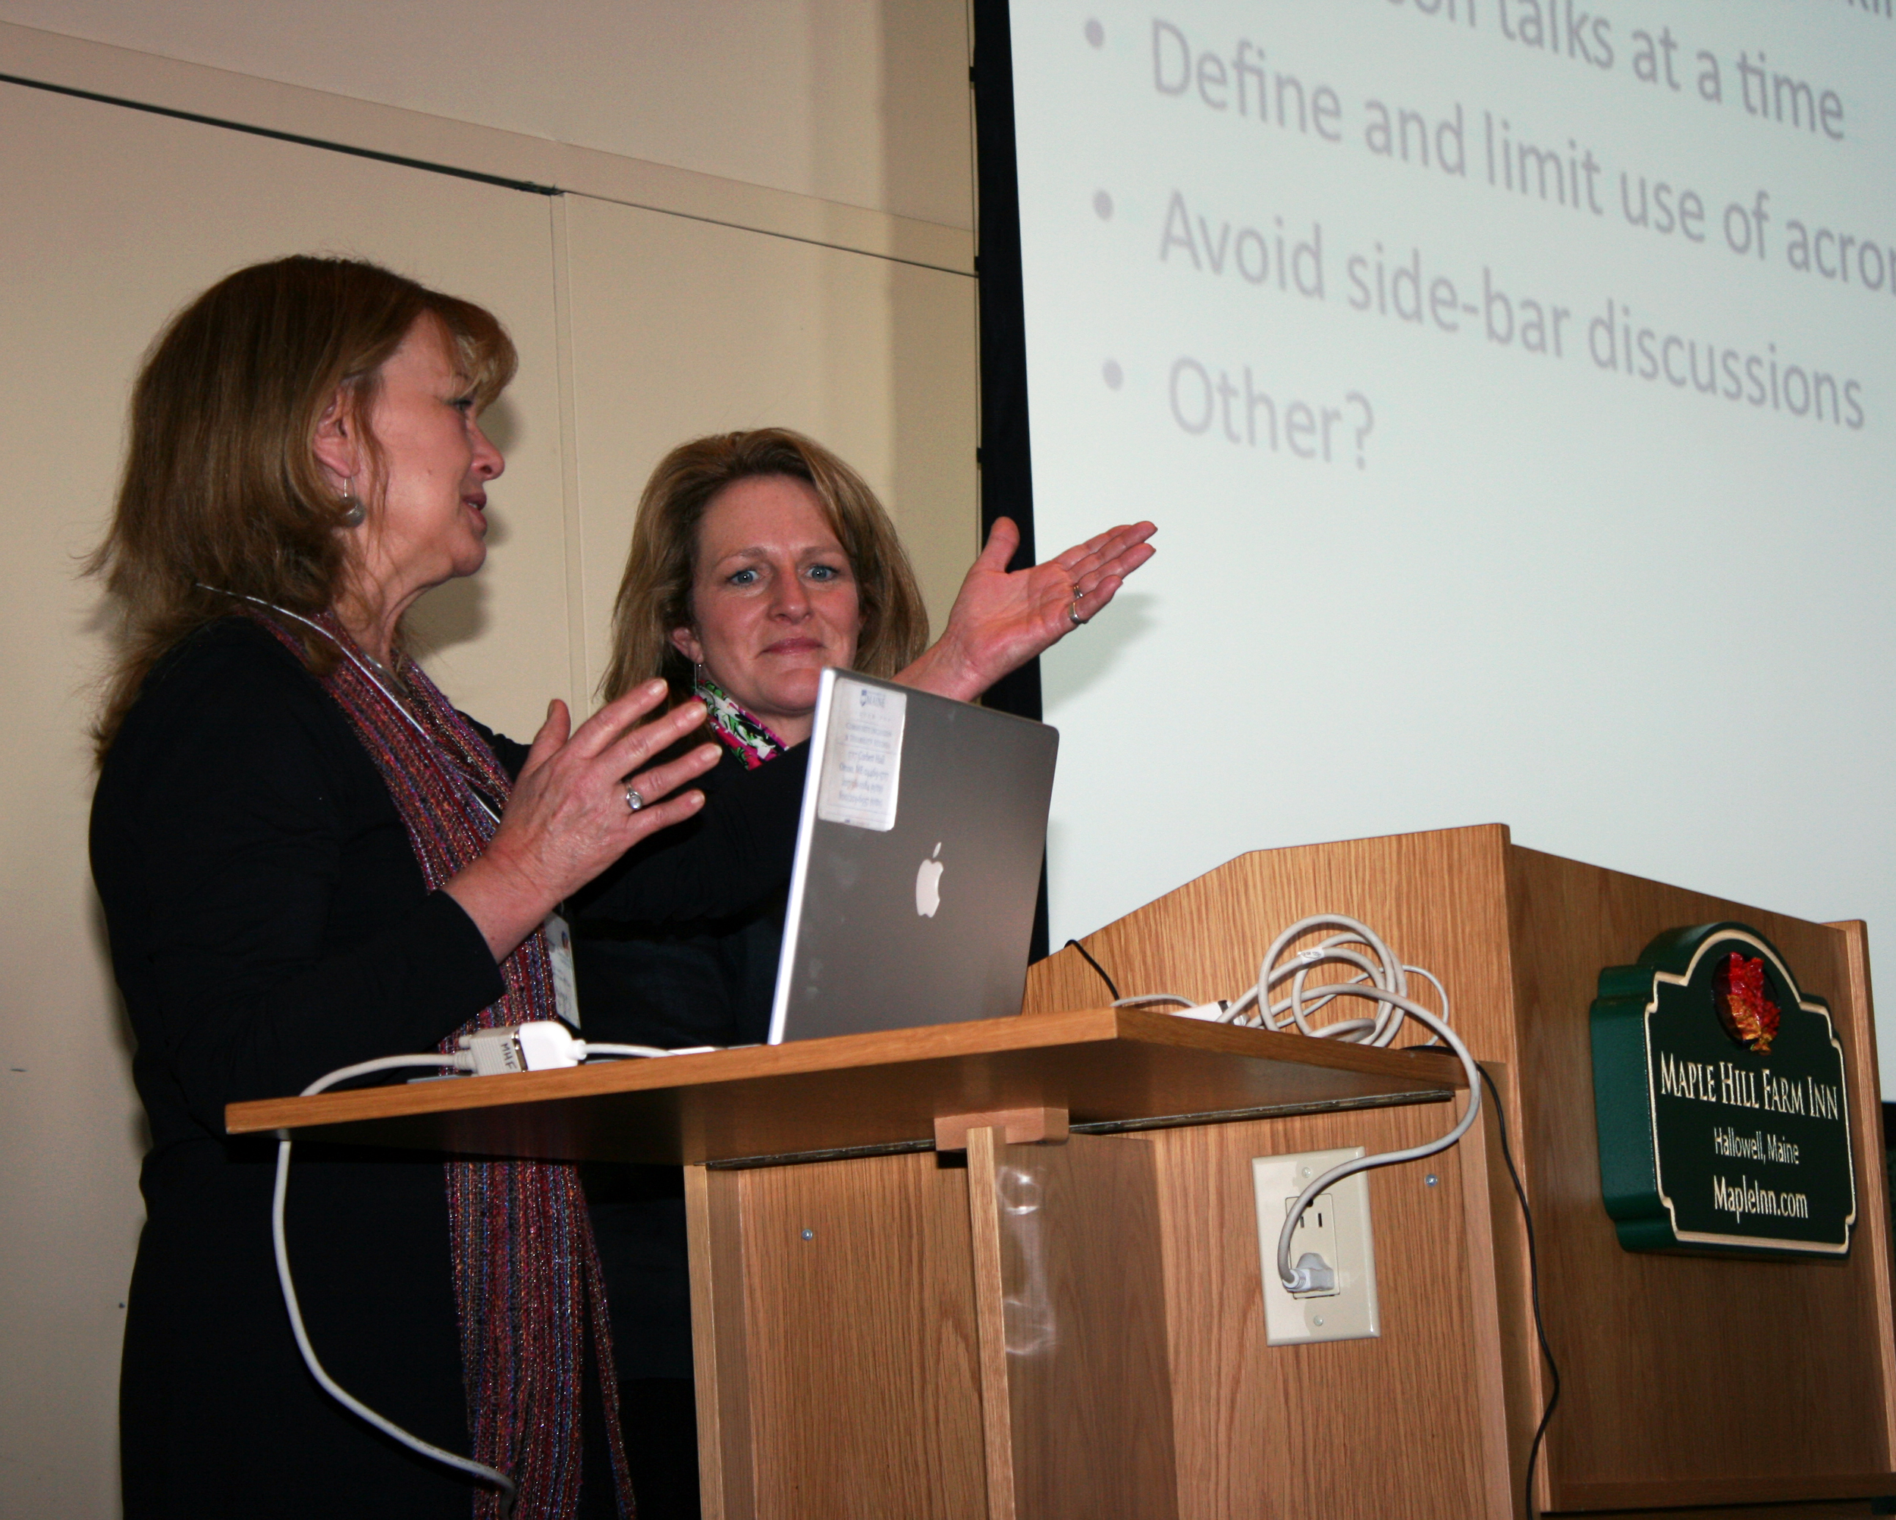
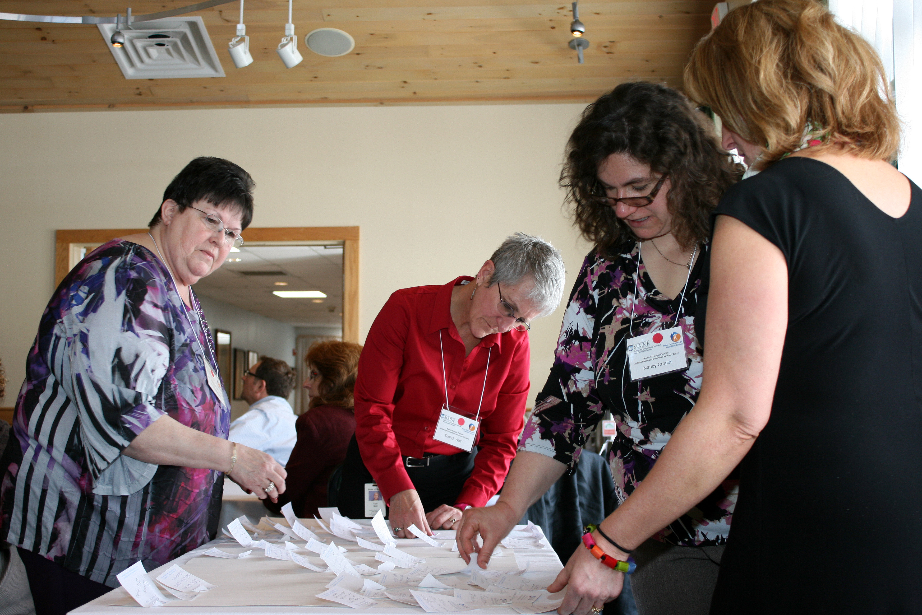
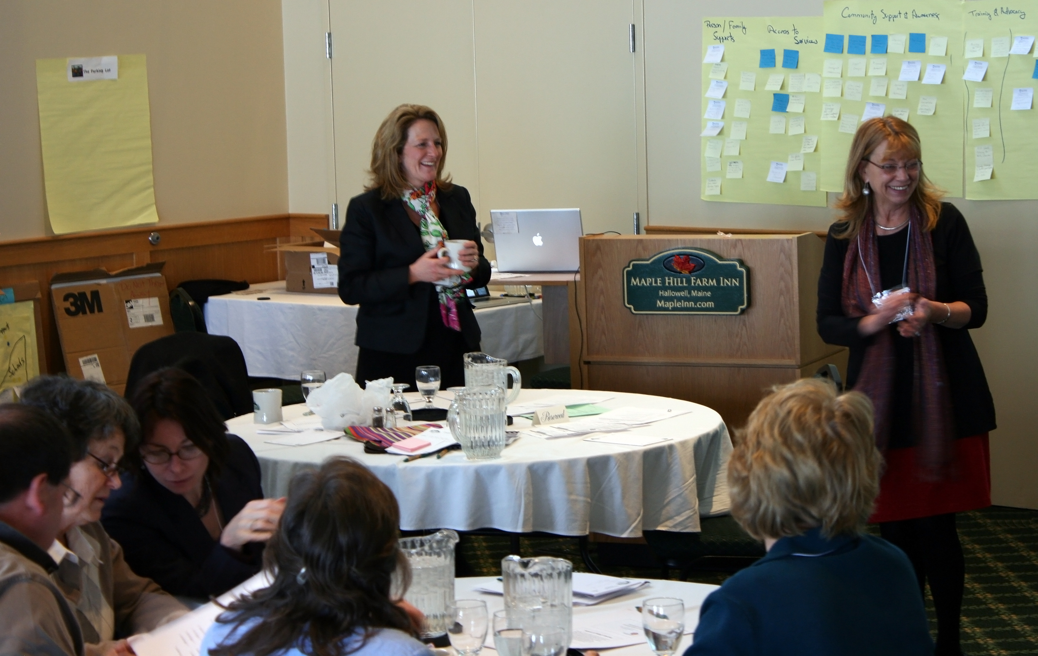
Maine Strategic Plan for Autism Spectrum Disorders and ACT Early Meeting
Facilitated by Jen Cammack and Debra Rainey
Purpose
To bring together a group of high level state leaders to discuss and plan initiatives to serve all individual with ASD In Maine
Leadership Development
Trainees facilitated the gathering of information on the following:
Progress in early identification of children with ASD;
Progress in the development of a system of care for individuals with ASD;
Barriers to effective supports for individuals with ASD; and
Summarized data and highlights of the meeting for the ASD Report.
Leadership Activities (what we did)
Developed agenda
Developed goals and objectives
Developed activities to meet the goal
Collaborated with stakeholders for comprehensive and efficient brainstorming using an affinity diagram method
Outcomes
Our data collection and collaboration with the State Liaison contributed to the final ASD report to DHHS and the State Legislature and enhanced improvements in early intervention, education, transition and adult services.

Slide 4
Family-Centered Transition Planning for Youth with ASD
(SPECS) Parent
Training
Person-Centered
Planning
Career
Exploration

Slide 5
FCTP
Great outcomes
Two published articles
Outcomes
Person-centered planning strategies
Current project - sustainability

Slide 6
ASD Related Activities (2)
Maine Autism Spectrum Resource Center
June 2013 - Presented in CT at the AMCHP Peer-to-Peer Conference with Nancy Cronin on Autism Implementation Grant, LEND, and transition activities
Data analysis for MDDC on experiences of Maine children and adults with ASD accessing quality healthcare

Slide 7
LEND Trainee Activities
ACT Early/ASD Implementation Grant Organization
CCIDS Transition Projects
Maine Autism Spectrum Resource Center
Development of Healthcare Transition Planning Strategies
FCTP Sustainability
Combating Autism Act Reauthorization

